Slide 1
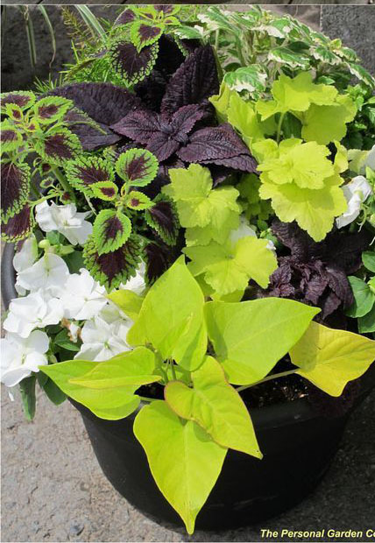
Shady
‘Scapes’
Splashes of White and Color in a Shady Garden
Presented to SGC 10/7/17 by Carolynne White

Slide 2
General Landscaping Tips
Use color and textures for impact and interest
Clump plantings
Complement, Contrast, and Highlight
Plan spacing for plants to mature
Group plants by light and water requirements
Notes:
The first 3 Tips on this page have to do with design and most landscapes in Southampton adhere to design principals.
However, the 4th can be a real issue especially when plants crowd sidewalks and other parts of landscaping when the plants mature.
Number 5 should be a given but often it is ignored.

Slide 3
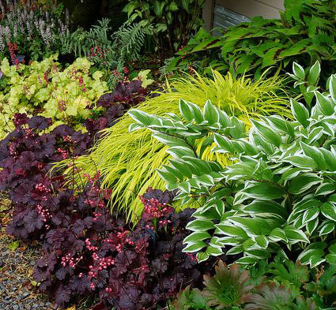
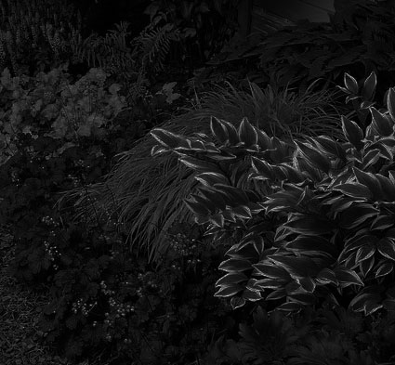
Add Interest to Shade
Daytime: Colors, Textures, Height differences
Evening: WHITE and LIGHT COLORS
Notes:
I have three slides of prettily landscaped shade gardens. In the first image, you can see the garden in daytime, the second is in the evening. If you are not careful, a shade garden can become a black-hole at nighttime

Slide 4
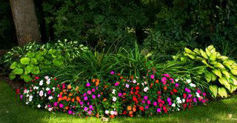
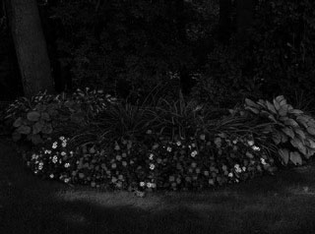
Look at another

Slide 5
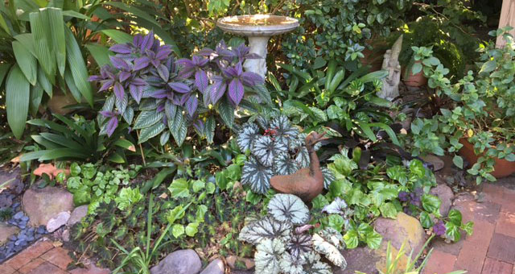
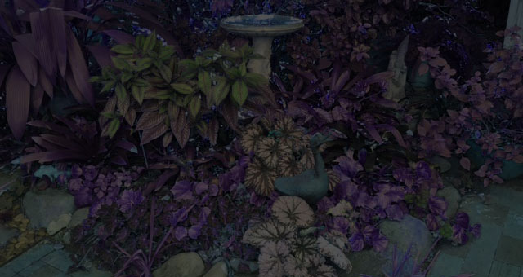
And one more

Slide 6
Color & Contrast
Flowers: Impatiens, Begonias, Bulbs
Leaf color: Coleus, Ferns, Aspidistra, Caladiums, Begonias
Textures: Ferns, Grasses
Size: Understory trees, Shrubs
  Height
  Width
Notes:
Color and Contrast and in this context, White is definitely a color

Slide 7
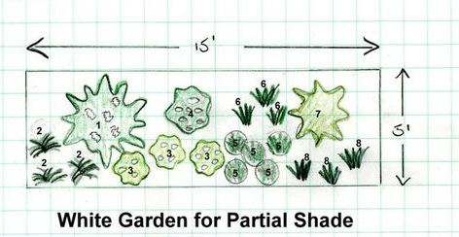
Plan Ahead!!!!
Horizontal Plan
Notes:
Landscaping should include a Horizontal plan

Slide 8
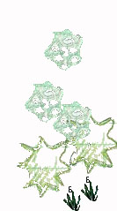
Vertical Plan
High: Understory trees
Medium:
  Shrubs
  Tall plants
Medium to Low:
  Perennials
  Annuals
  Groundcovers
5 Ft
Notes:
And a vertical plan

Slide 9
Complement & Contrast
Bright and Dark versus Light or White
Soft textures versus Strong textures
Horizontal versus Vertical lines
Notes:
Quick review

Slide 10
Use a Combination of Plants and Pots in a Shade Garden
Low plants in pots become medium or tall plants in pots.
Notes:
If you cannot put plants in the ground, put them in pots and arrange them amongst other plants and pots.

Slide 11
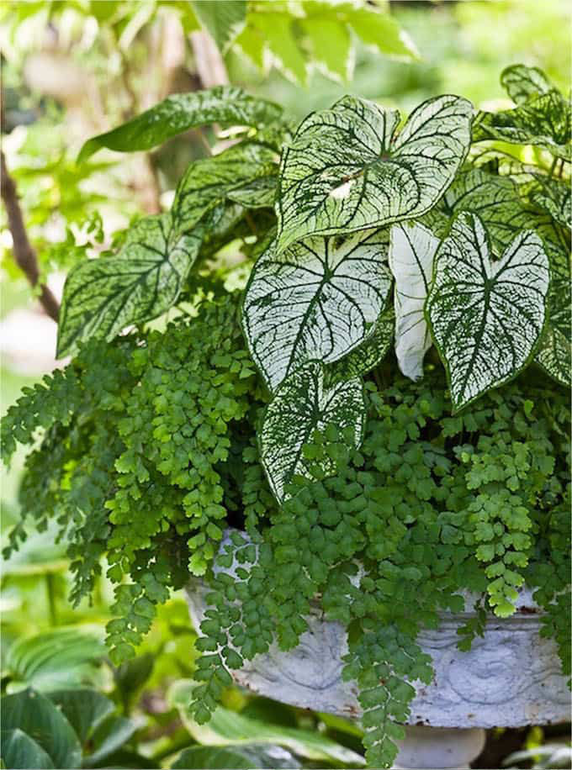
Combo 1 for Pots & Shady Gardens
Caladiums
Maidenhair Fern
Notes:
I have several “pot combinations” to show you as possible plants combinations for a shade garden.
In Huston, Caladiums are very very versiital additions to any garden.

Slide 12
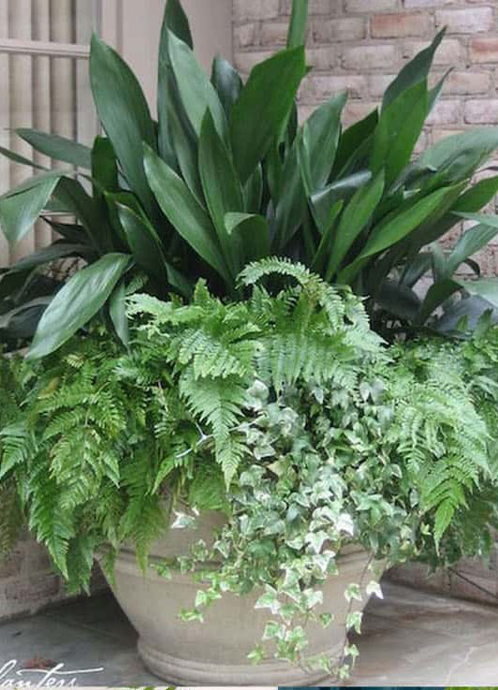
Combo 2 for Pots & Shady Gardens
Aspidistra
Fern
Variegated Ivy
Notes:
We all have aspidistra somewhere but here it is a stunning contrast with light colored ferns and ivies.

Slide 13
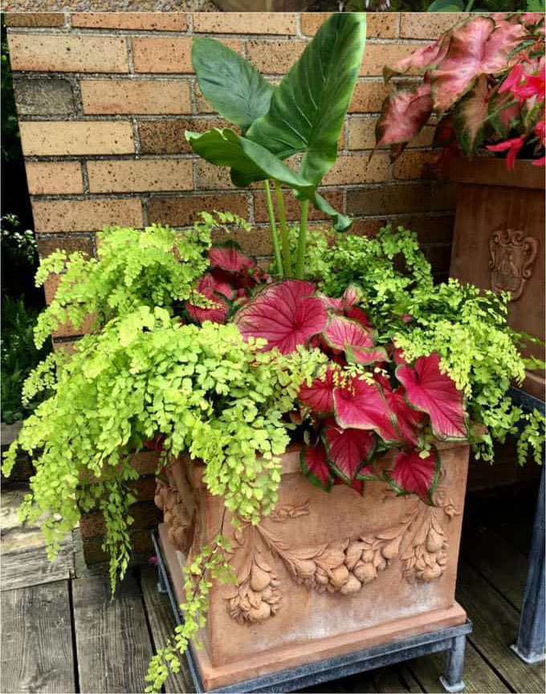
Combo 3 for Pots & Shady Gardens
Elephant Ears
Maidenhair Fern
Caladium
Notes:
I really like Elephant Ears and paired with caladiums and maidenhair, it is a winner!

Slide 14
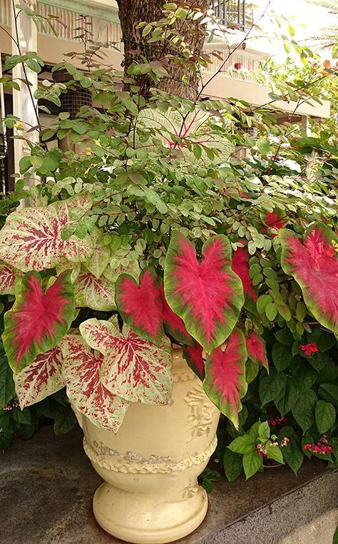
Combo 4 for Pots & Shady Gardens
Small shrub
Caladium
Notes:
I do not know the small shrub that is used here but it pairs very nicely with two types od caladiums

Slide 15
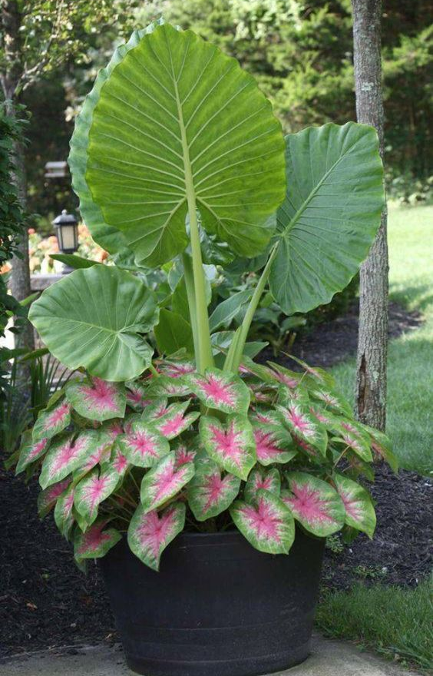
Combo 5 for Pots & Shady Gardens
Elephant Ears
Caladium
Notes:
This one is simply elephant ears and caladium. The combo would work very well in a garden. One concern would be the fact that the combo will only work for 6-8 months of the year.

Slide 16
Notice a Trend?
Foliage, not Flowers!

Slide 17
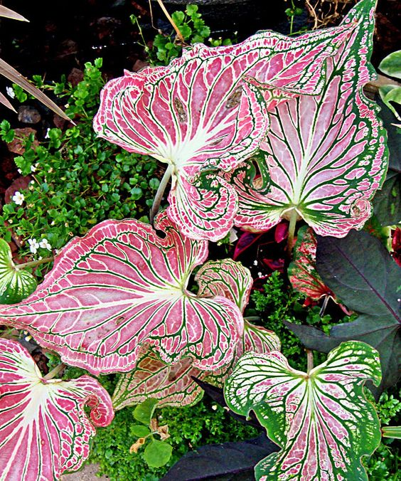
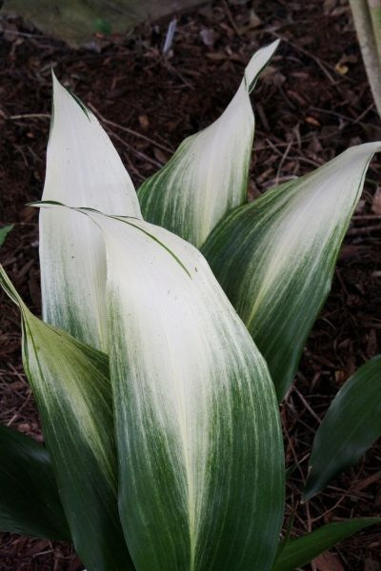
Leaf Color - Houston
Caladiums
Elephant Ears
Aspidistra
Caladium 'Thai Beauty'
Aspidistra ‘Snow Cap’
Notes:
Aspidistra will look the same (may get a little ragged) year around. I grow mine in a pot for the most part because it can take over.

Slide 18
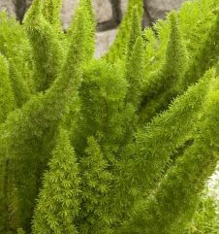
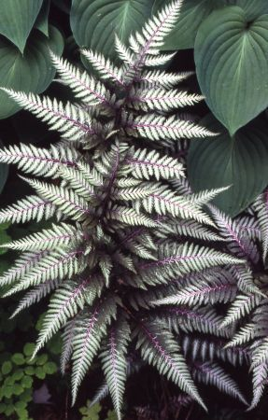
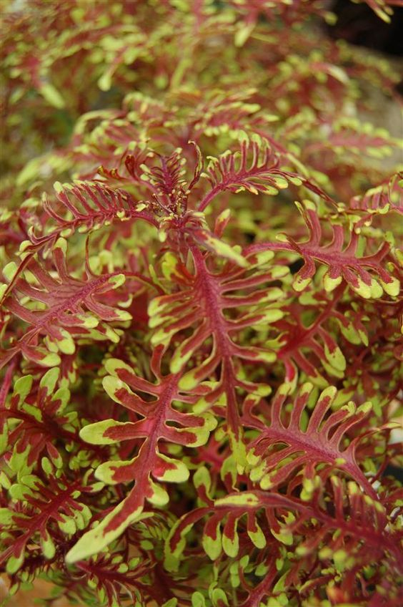
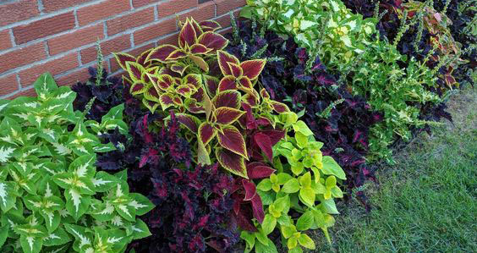
Leaf Color - Houston
Ferns
  And fakes
Coleus
  Standard
  Under the Sea
Japanese Painted Fern ’Silver Falls'
Coleus ’Bone Fish'
Notes:
Here are some other possibilities:
FERNS from the sleek and tall Holly fern to the almost flat Japanese painted fern. Don’t ignore Foxtail ferns (even if they are not really ferns) Their light green and feathery texture works year around.
And COLEUS can be a real color champion for a shade garden. Even though the “Under the Sea” variety can grow in sunny locations. It does very well in my shade garden. The standard coleus is a shade lover!

Slide 19
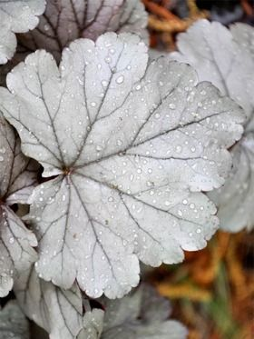
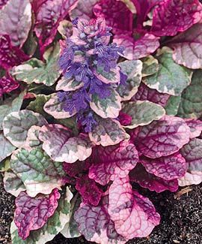
More!
Heuchera
Ajuga
Heuchera ‘Stainless Steel’
Ajuga ‘Burgundy Glow’
Notes:
There are other exotic “leaves” that provide contrast in your gardens.
Ajuga is a groundcover that is available in a variety of colors and textures.
Heuchera – I called these “coral bells” when I was growing up – are available in a variety of colors/

Slide 20
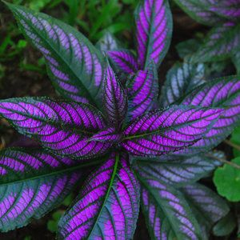
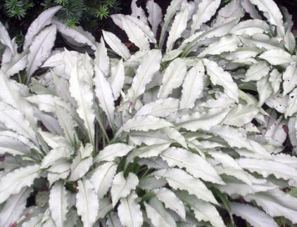
More!
Persian Shield
Persian Shield
Aluminum plant
Sweet Potato Vine
  Lime Green & Purple
Spider Plant
Wandering Jew
Hostas
Dichrondra
Pulmonaria
Plus many more!
Pulmonaria
‘Silver Shimmers’
Notes:
You can see by this list that I have barely shown you the tip of the iceberg in exotic colors of leaves. I am growing (in pots) Persian Shield, Sweet Potato Vine, Spider plant, Hostas, and Dichrondra,.

Slide 21
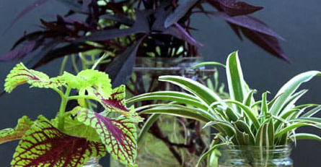
One very nice feature:
Many of these are easy to propagate!
Notes:
If anyone is interested in cuttings, please let me know. Of if anyone has any curttings to offer, please do the same.

Slide 22
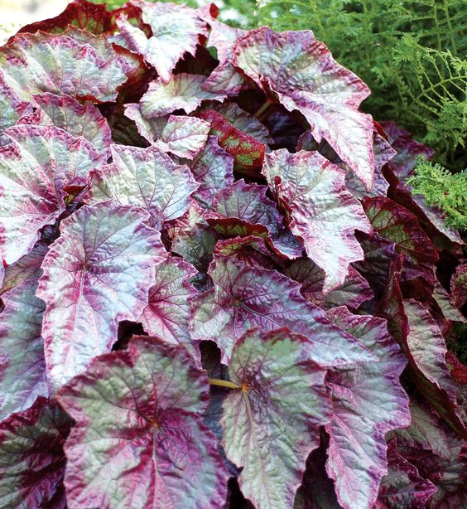
Begonias I
Not just Wax Begonias!
Flowers
  Usually Red – white range
  Except tuberous which won’t grow here
Blooming season
  Short for some
  Whole season for others
Notes:
Because we had Cheryl Lenert speak to us on Begonias, I wanted to give them a little extra attention.

Slide 23
Begonias II
Some hardy
  May be in ground
Some not hardy
  House Plants

Slide 24
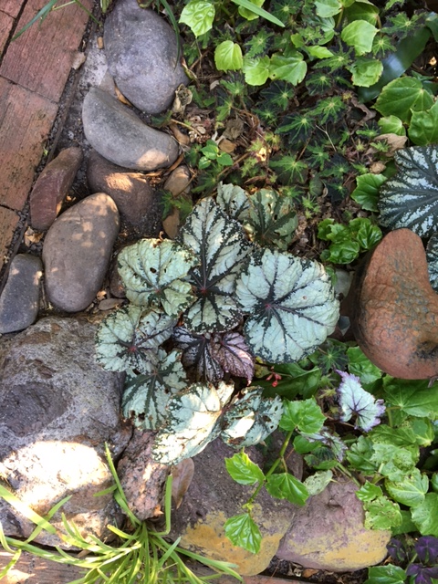
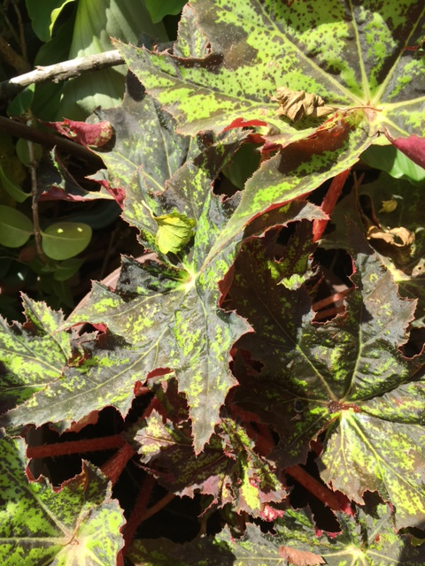
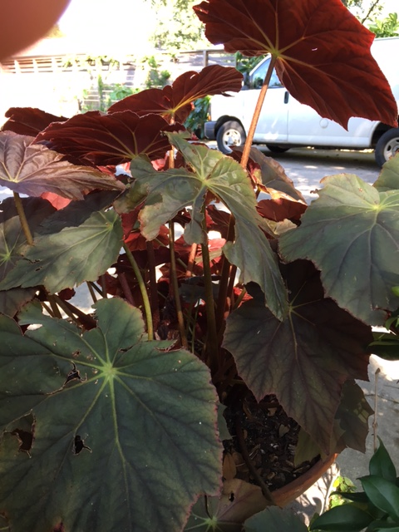
Begonias III
Leaf Color and Design

Slide 25
Flowers in the Shade?
Begonias
  White, pink, red
Impatiens
  White, pink, red, orange, lavender
New Guinea Impatiens (Leaf color also)
Lantana
Plumbago (can be staked for height)
  Blue
Gingers (Leaf color also)
Hydrangas

Slide 26
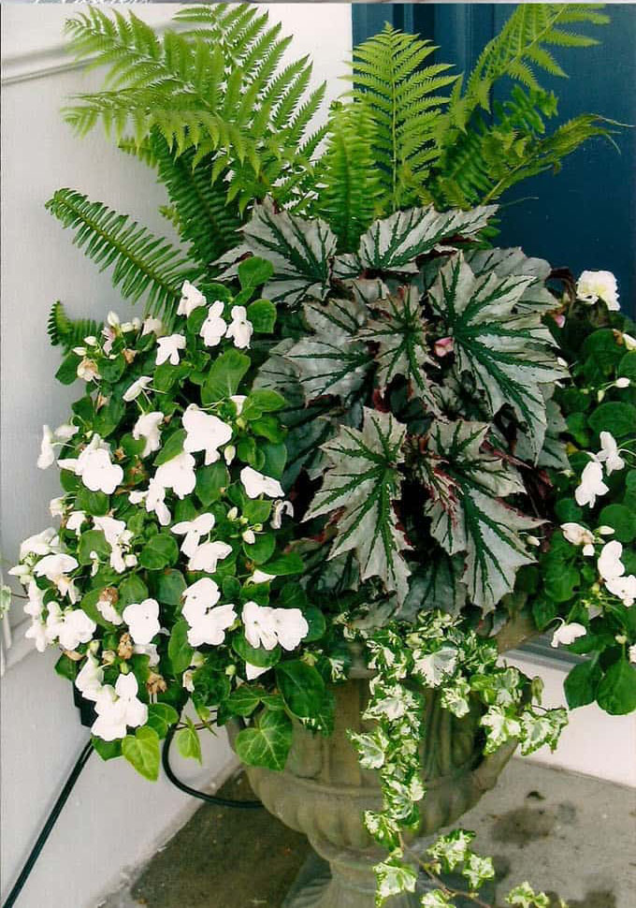
With Flowers!
Ferns
  Boston and Woods
Begonia (leaf color)
Impatiens (white)
Variegated Ivy

Slide 27
With Flowers!
Coleus
Sweet Potato vine
Impatiens (white)
Heuchera

Slide 28
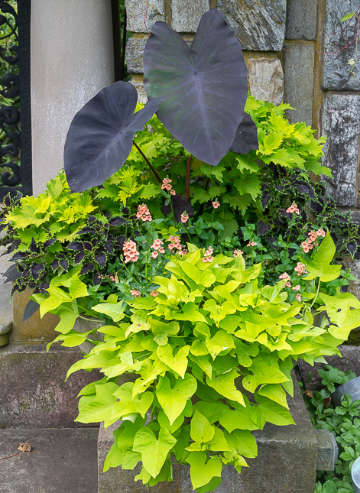
With Flowers!
Elephant Ears
Coleus
Sweet Potato vine

Slide 29
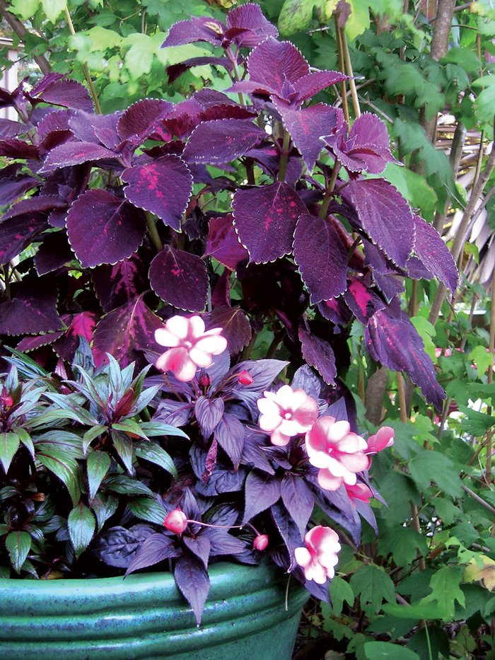
With Flowers!
Coleus
New Guinea Impatiens
(2 varieties)

Slide 30
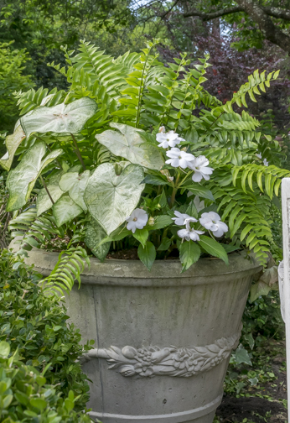
With Flowers!
Ferns
Impatiens
Caladiums

Slide 31
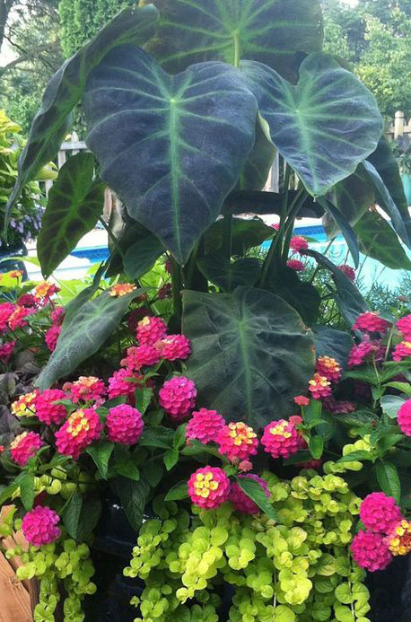
With Flowers!
Elephant Ears
Lantana
Creeping Jenny
(Lysimachia)

Slide 32
Tall Shade Plants
Thrillers (Height)
  Elephant Ears
  (both green and purple)
  Large Ferns (Holly, Woods, Table)
  Aspidistra (especially with white “highlights”)
  Palm Grass
  Tall Coleus
  Butterfly Ginger
  Plumeria (if staked)

Slide 33
Medium Height Plants
Fillers (Medium Height)
  Coleus
  Caladium
  Lantana
  Begonia
  New Guinea Impatiens
  Maidenhair fern
  Foxtail “Fern”
  Airplane plants
  Aluminum Plant
  Persian Shield

Slide 34
Low Height Plants
Spillers (Low Height)
  Ajuga
  Wax Begonias
  Sweet Potato Vine
  Heuchera
  Japanese Painted Fern
  Peacock Ginger
  Hostas
  Variegated Ivy
  Creeping Jenny
  Wandering Jew
  Dichronda

Slide 35
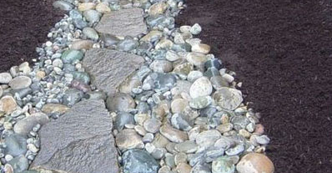
How about Rocks?

Slide 36
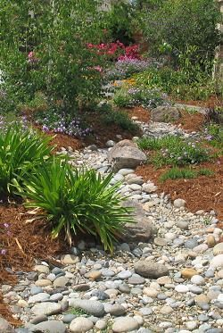
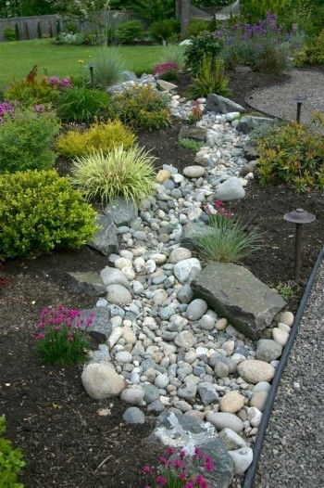
Dry “Creek Beds”
Add
interest
Help with
drainage

Slide 37
Watering & Other Tips
Automatic System
  For Sprinklers, Use High Risers (24”)
    Takes care of most pots & plants
  Drip System
    Use mini drip hoses
Place Pots on Concrete Blocks
Mulch on Ground and in Pots

Slide 38
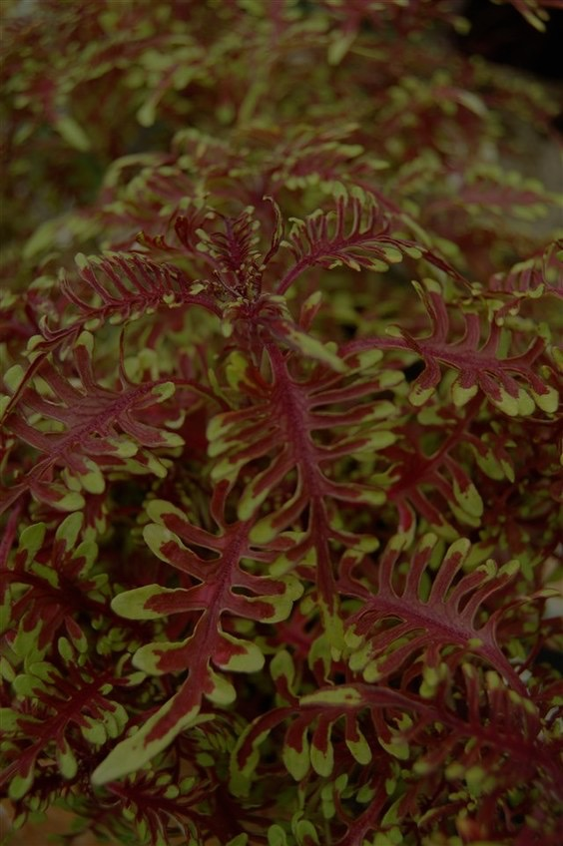
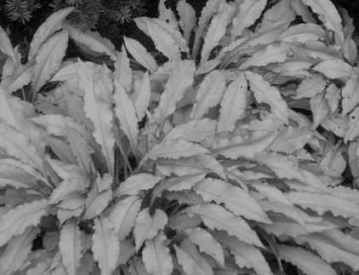
STARS of the
SHADE

